Slide 1
Proyecto Fase Final
Curso: Sistemas operativos II

Slide 2

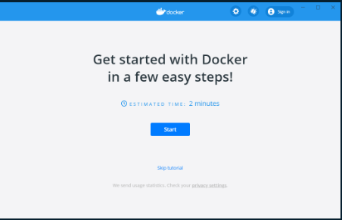
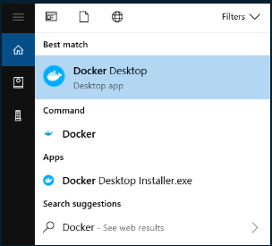
Instalación de Docker Desktop para Windows.

Slide 3
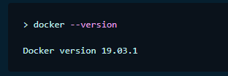
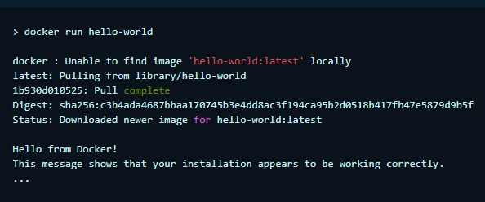

Slide 4

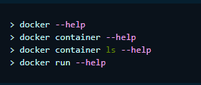


Slide 5
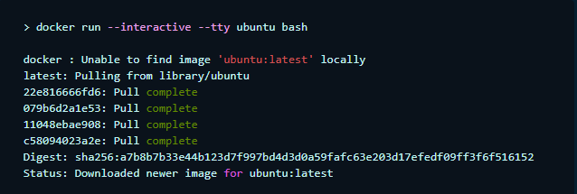

Slide 6
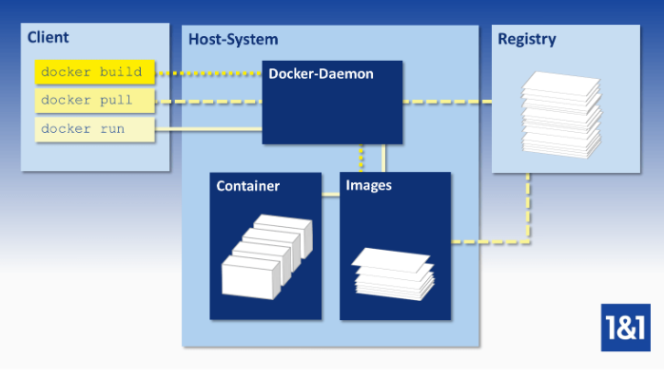
3. instalacion de docker-machine

Slide 7
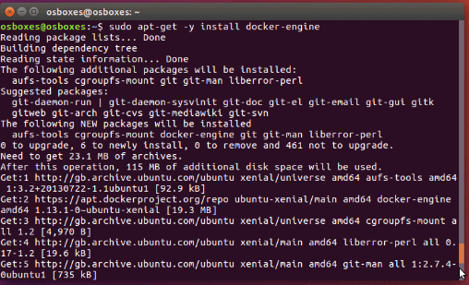

Slide 8
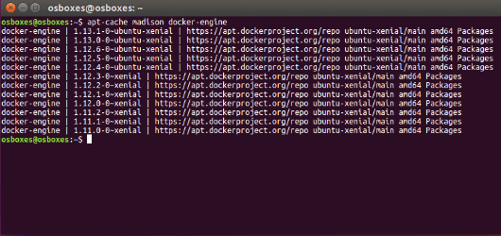
instalacion de docker engine

Slide 9
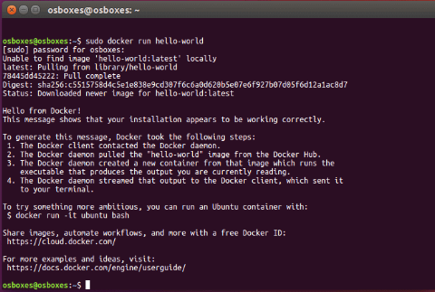

Slide 10
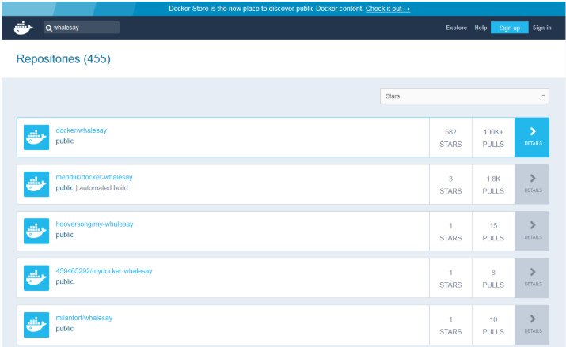

Slide 11
5. Como crear un swarm:
$ docker-machine create --driver digitalocean --digitalocean-access-token xxxxx docker-sandbox
$ docker-machine create --driver amazonec2 --amazonec2-access-key AKI******* --amazonec2-secret-key 8T93C******* aws-sandbox
docker-machine ssh MACHINE-NAME
docker swarm init [OPTIONS]

Slide 12
Swarm initialized: current node (1ia0jlt0ylmnfofyfj2n71w0z) is now a manager.
To add a worker to this swarm, run the following command:
docker swarm join \
--token SWMTKN-1-511cy9taxx5w47n80vopivx6ii6cjpi71vfncqhcfcawxfcb14-6cng4m8lhlrdfuq9jgzznre1p \
10.0.2.15:2377
To add a manager to this swarm, run 'docker swarm join-token manager' and follow the instructions.
ID HOSTNAME STATUS AVAILABILITY MANAGER
jhy7ur9hvzvwd4o1pl8veqms3 worker2 Ready Active
jukrzzii3azdnub9jia04onc5 worker1 Ready Active
1ia0jlt0ylmnfofyfj2n71w0z * osboxes Ready Active Leader

Slide 13
6. Conexión SSH a cada nodo:
FROM php:7.2.13-fpm-alpine3.8
ENV SSH_PORT 2222
RUN apk add --update openssh supervisor \
&& rm -rf /tmp/* /var/cache/apk/*
RUN mkdir -p /var/run/sshd /var/log/supervisor
RUN echo 'root:Docker!' | chpasswd
COPY sshd_config /etc/ssh/
ADD supervisord.conf /etc/supervisord.conf
COPY docker-entrypoint.sh /usr/local/bin/
RUN chmod -R +x /usr/local/bin
EXPOSE 2222
ENTRYPOINT ["docker-entrypoint.sh"]
CMD ["supervisord", "--nodaemon", "--configuration", "/etc/supervisord.conf"]

Slide 14
# This is ssh server systemwide configuration file.
#
# /etc/sshd_config
Port 2222
ListenAddress 0.0.0.0
LoginGraceTime 180
X11Forwarding yes
Ciphers aes128-cbc,3des-cbc,aes256-cbc,aes128-ctr,aes192-ctr,aes256-ctr
MACs hmac-sha1,hmac-sha1-96
StrictModes yes
SyslogFacility DAEMON
PasswordAuthentication yes
PermitEmptyPasswords no
PermitRootLogin yes
Subsystem sftp internal-sftp

Slide 15
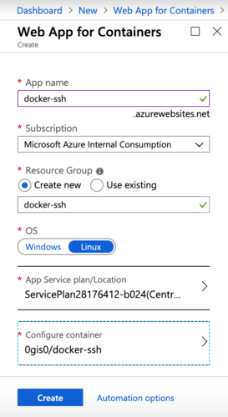

Slide 16
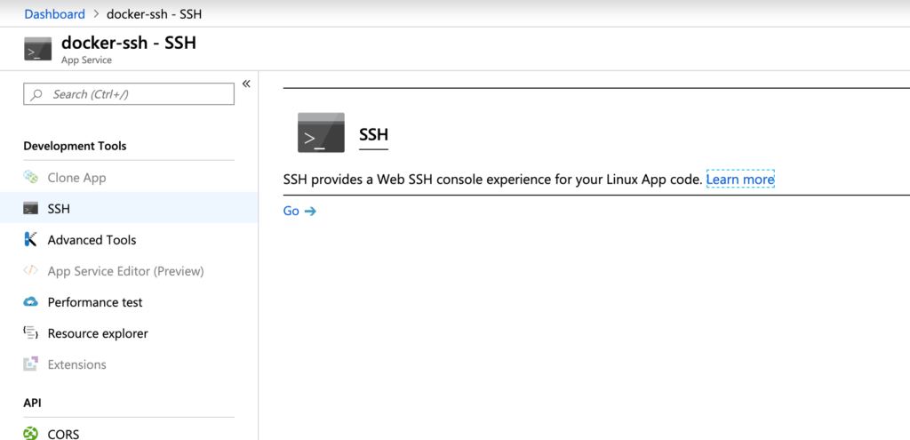
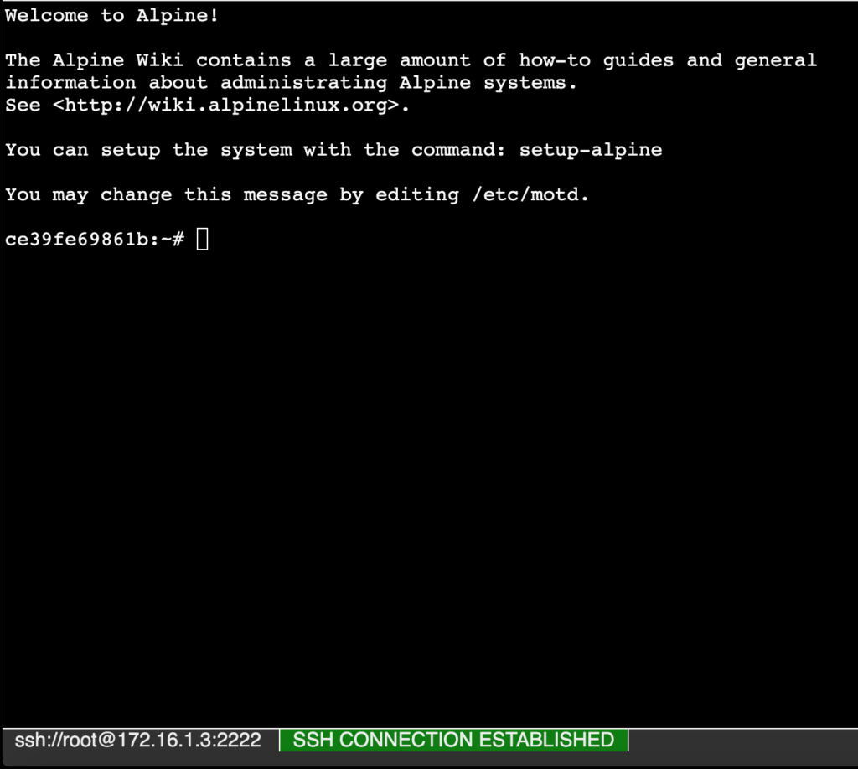

Slide 17
7. Agregar Nodos al Swarm:
$ docker service create --replicas 1 --name helloworld alpine ping enmilocalfunciona.io
$ docker swarm join --token SWMTKN-1-50edlk935u9qgvrs8alhpzf1awgdil2dmfs4zgpd8ue2ltkmww-3y9tb0pjnieqao9ahkutpvpxe 192.168.3.80:2377
This node joined a swarm as a worker.

Slide 18
$ docker service ls
ID NAME SCALE IMAGE COMMAND
9uk4639qpg7n helloworld 1/1 alpine ping enmilocalfunciona.io
$ docker swarm init --advertise-addr 192.168.3.80
Swarm initialized: current node (cf2mywzpa3pd77z23u5jciqwi) is now a manager.
To add a worker to this swarm, run the following command:
docker swarm join \
--token SWMTKN-1-50edlk935u9qgvrs8alhpzf1awgdil2dmfs4zgpd8ue2ltkmww-3y9tb0pjnieqao9ahkutpvpxe \
192.168.3.80:2377
To add a manager to this swarm, run the following command:
docker swarm join \
--token SWMTKN-1-50edlk935u9qgvrs8alhpzf1awgdil2dmfs4zgpd8ue2ltkmww-06m3vta11n4ihjyr1ytycwqvf \
192.168.3.80:2377

Slide 19
8. Crear el Repositorio Privado:

